Slide 1



CPOL Antenna and DTMF Control Capstone Senior Design Project June 2nd, 2015
Tim Bodkin
Kevin Helms
Chris Tatosian
Luis Ceja Quiroz

Slide 2
Amateur Radio
What is Amateur Radio?
“Radio amateurs, often called “hams,” enjoy radio technology as a hobby. But it's also a service –a vital service that has saved lives when regular communication systems failed.”
What’s the appeal of Ham Radio?
“Hams are at the cutting edge of many technologies. They provide thousands of hours of volunteer community and emergency services when normal communications go down or are overloaded. All of them enjoy being creators, not just consumers, of wireless technology.” – ARRL

Slide 3
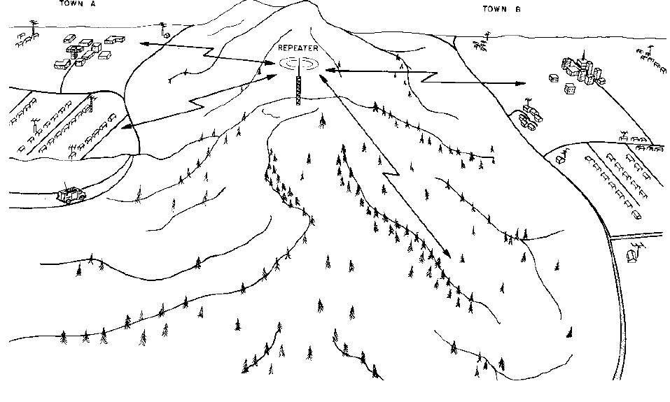
Repeaters
Widely used in amateur radio for wireless RF amplification
UCSC ARC repeater receives at 144.710 MHz, transmits at 145.310 MHz
Typically rely on line-of-sight communications

Slide 4
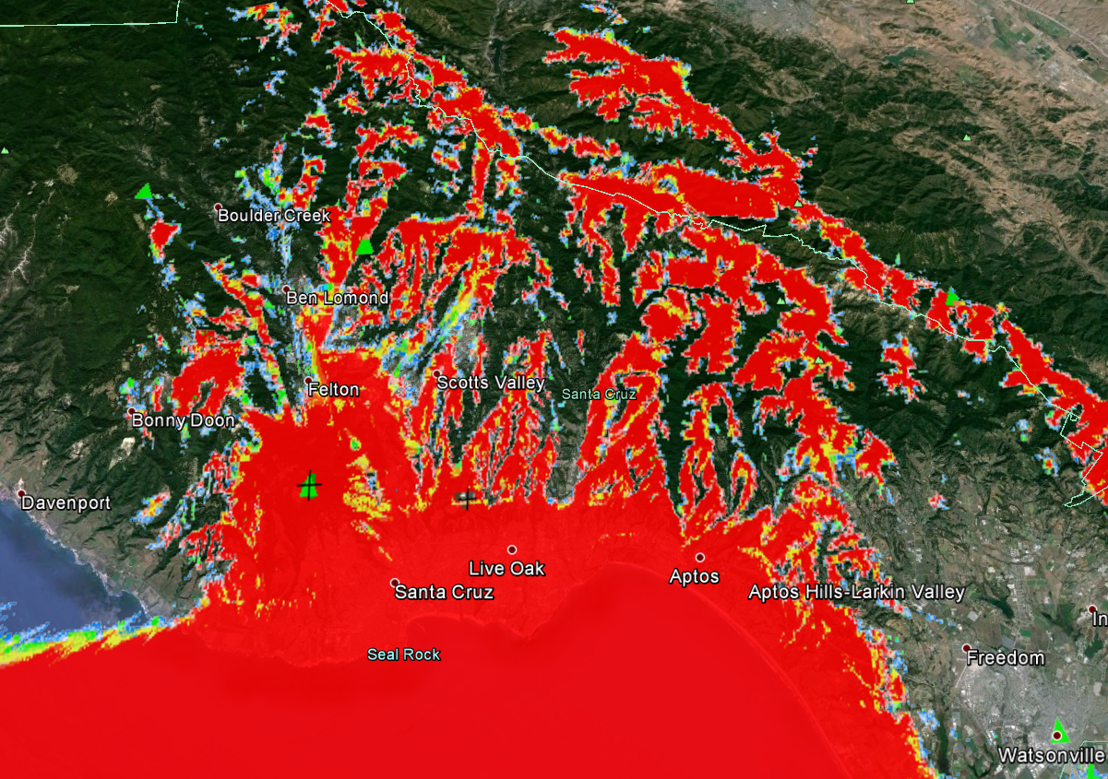
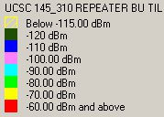
Motivation
Degraded signal integrity of the UCSC repeater due to local terrain
Provide wider range of connectivity to the repeater and Amateur Radio community
Coverage area propagation model

Slide 5
Approach
Modular System Design
Numerical EM Code Simulation
Augmentation of UCSC Repeater System
Permanent Installation

Slide 6
System Overview
Circularly polarized antenna array
Antenna switching circuit
DTMF controller
RoIP nodes
Audio linking Interface

Slide 7
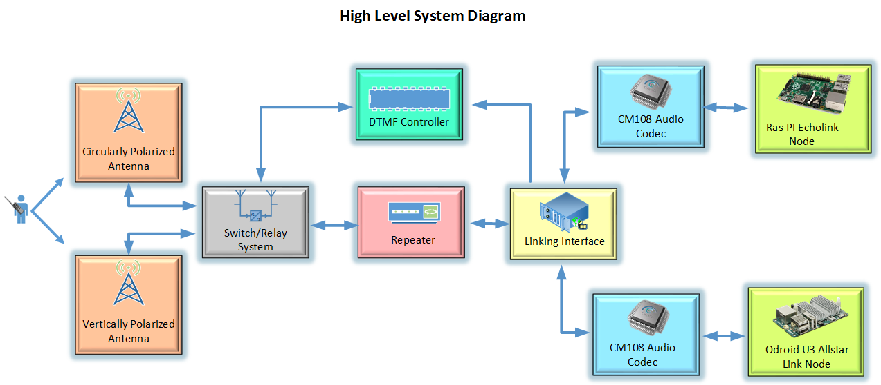
Challenges

Slide 8
DTMF Controller
Central control for the antenna switching system
Decodes DTMF Sequences
Verifies DTMF sequences through hardware and switches between the VPOL and CPOL antenna upon an appropriate sequence
Closed Loop Feedback

Slide 9
Design and Implementation
Initial Design included DTMF decoder chip MT8870 and an Atmega328P
Atmega 328P provides enough GPIO ports for desired inputs, outputs, and additional pins for future work
Atmega 328P inputs are compatible with Decoder outputs
Software
Incoming DTMF Tones
Prep Antenna Switching process upon correct sequence
Inhibit repeater during the switching of antennas
Verify Successful Switch with feedback from Switching Circuit

Slide 10
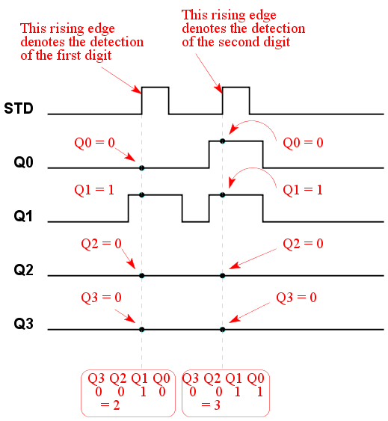
Challenges
No confirmation of successful Antenna switching
Initial design: Pulsed inputs
Changes occur when a tone is decoded
Sacrifice of 1 tone
Asynchronous: timing errors
Slow DTMF Decoding

Slide 11
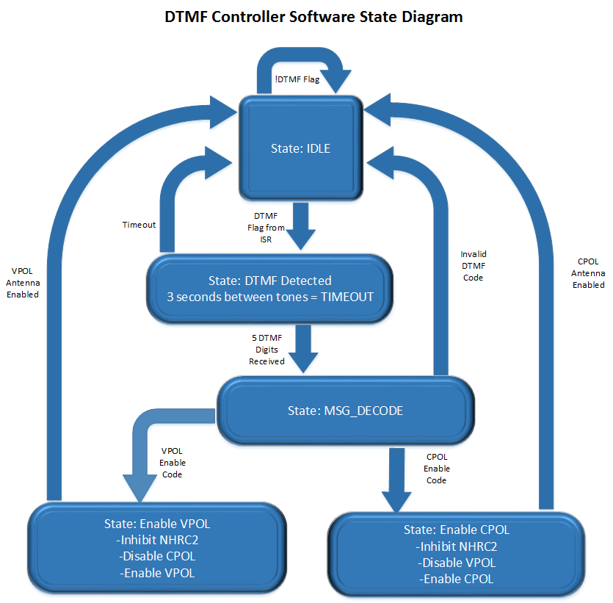
DTMF Software State Diagram

Slide 12
Results / Final Design
Latched DTMF decoded inputs
All tones usable
Faster Decoding Time
LCD Display
Status LED’s
Manual Switch
Audible Tone

Slide 13
Switching Circuit Overview
Real time antenna switching
Provides power to antenna relays
Digital control and feedback signals

Slide 14
Initial Design and Implementation
24 Volt Coaxial Relay
Power Supply
Digitally Controlled Power MOSFETs
Digital Feedback Signals

Slide 15
Challenges
Rectified DC Voltage
Power Resistor Temperature
Insufficient Feedback
Relay Temperature

Slide 16
Final Design
Project Enclosure
DB9 Connections
Status LEDs

Slide 17
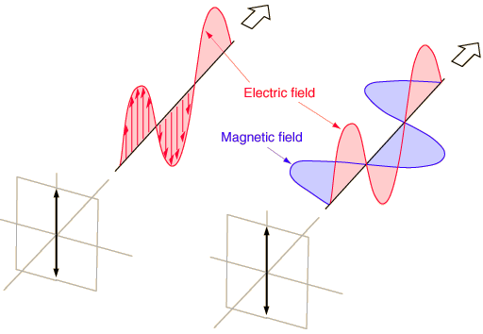
Vertical Antenna
Current antenna is vertical, linearly polarized

Slide 18
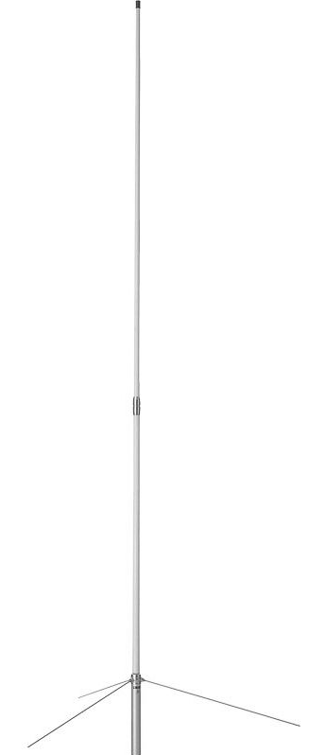
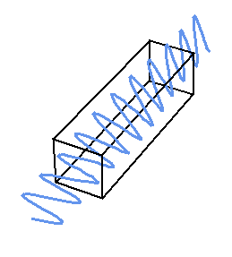
Vertical Antenna
Coverage areas obstructed by trees, hills, buildings, etc.
Polarization angle can be shifted, as the wave propagates
This results in significant power loss (20+ dB) if cross-polarized

Slide 19
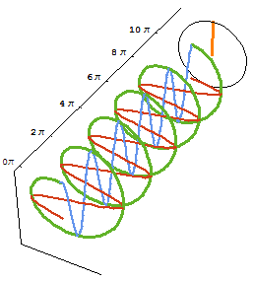
CPOL Antenna
Circular polarization can offer significant improvement in repeater performance
Immune to changes in polarization angle
3 dB loss regardless of linear polarization angle

Slide 20
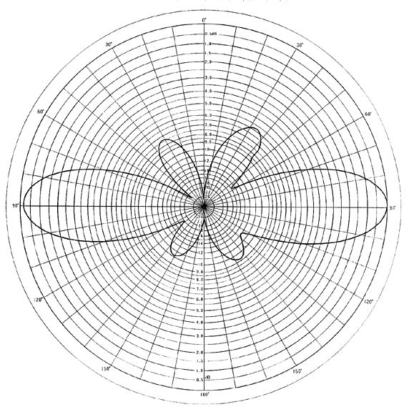
CPOL Antenna Design Specifications
Omnidirectional multi-element antenna array which radiates with circular polarization
Achieve gain comparable to current linear antenna (6.7 dBi in the horizontal)

Slide 21
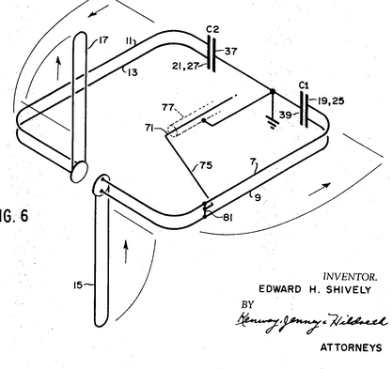
CPOL Antenna Approach
Design based on Shively patent (circa 1971), alternatively using copper tubing and a balanced feed line
Optimize gain and axial ratio in NEC simulation

Slide 22
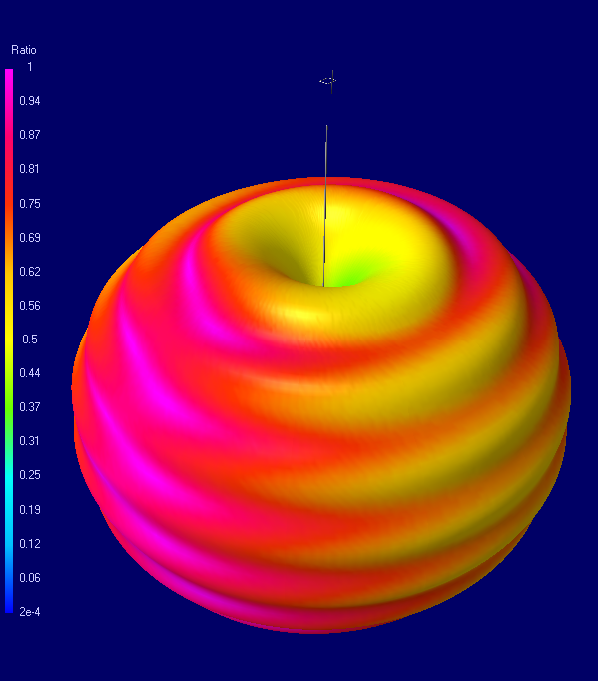
Initial Design Simulation Results
Achieves circular polarization, but low axial ratio in front and back
Single element horizontal gain of 2.3 dBi
Free space radiation pattern.

Slide 23
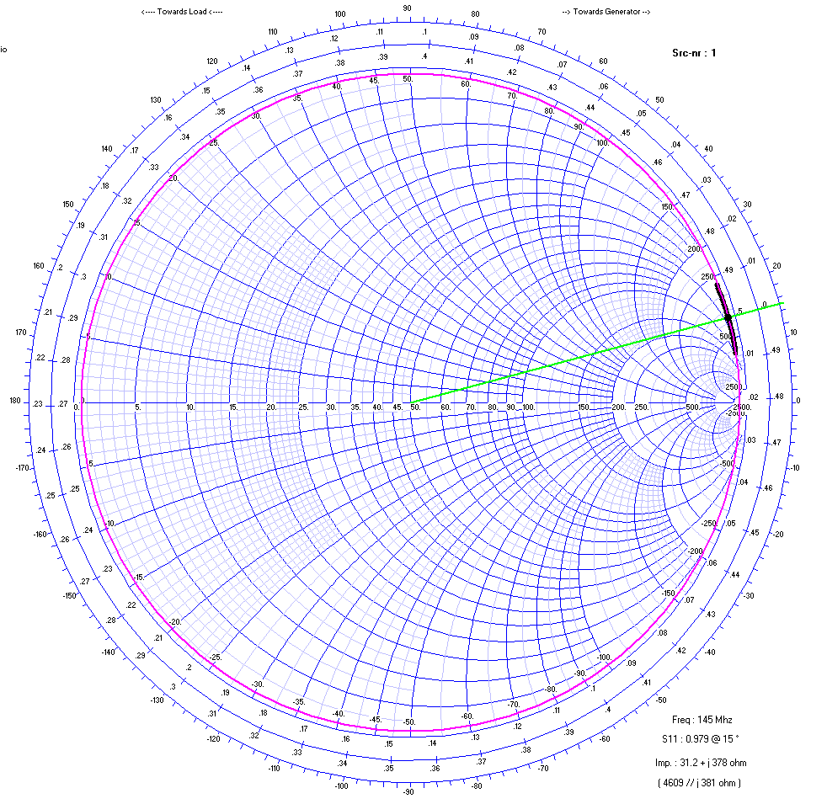
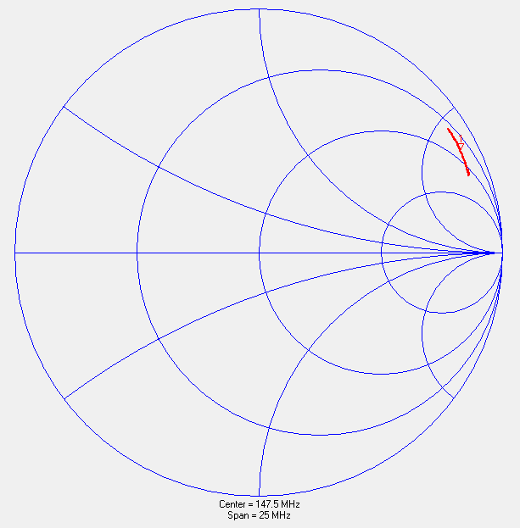
Results Feed Impedance
Simulation
Measurement

Slide 24
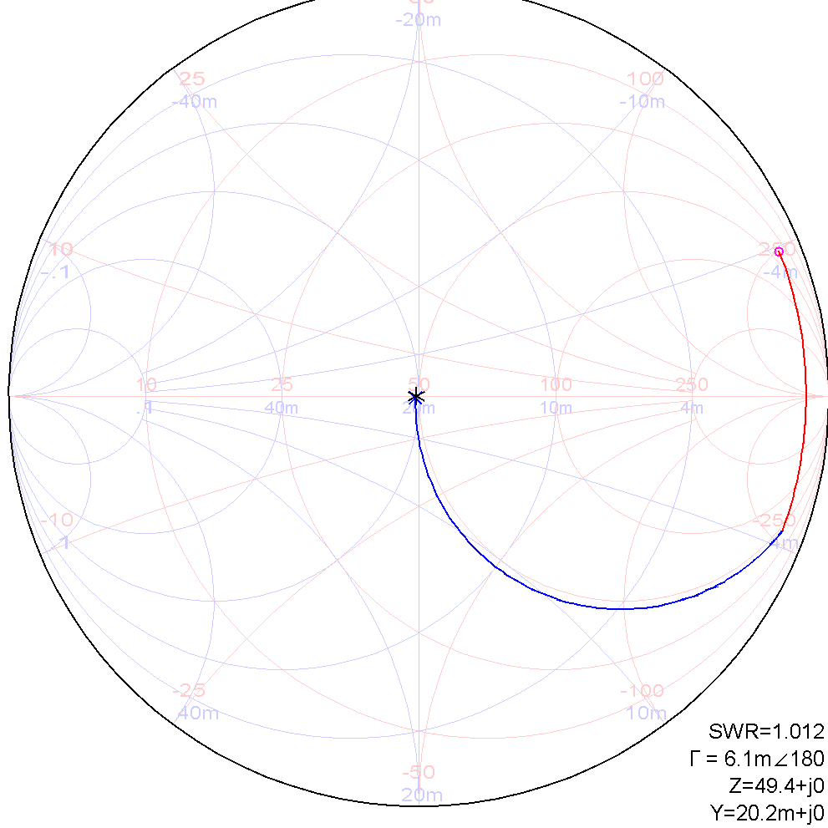
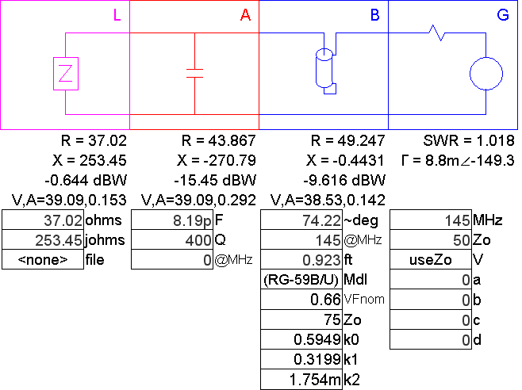
Impedance Matching Network Simulation

Slide 25
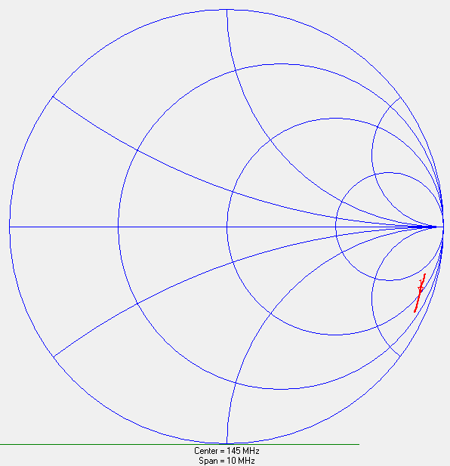

Impedance Matching Network Results

Slide 26
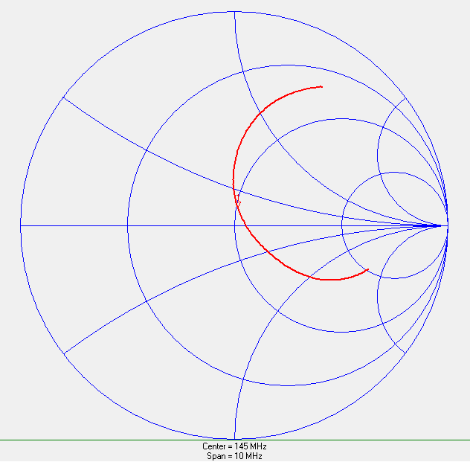
Impedance Matching Network Results
Z @ 145.310 MHz = 50.93 + j9.7
VSWR = 1.18
Z @ 144.710 MHz = 57.67 – j1.2
VSWR = 1.155

Slide 27
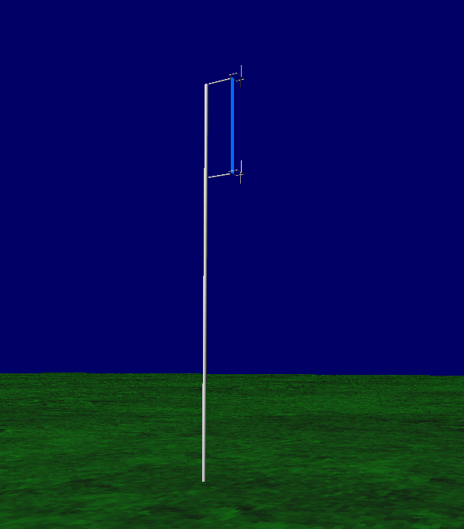
Final Design
Single element antenna lacks required gain to meet specs
Final design will consist of a two-element, phased array

Slide 28
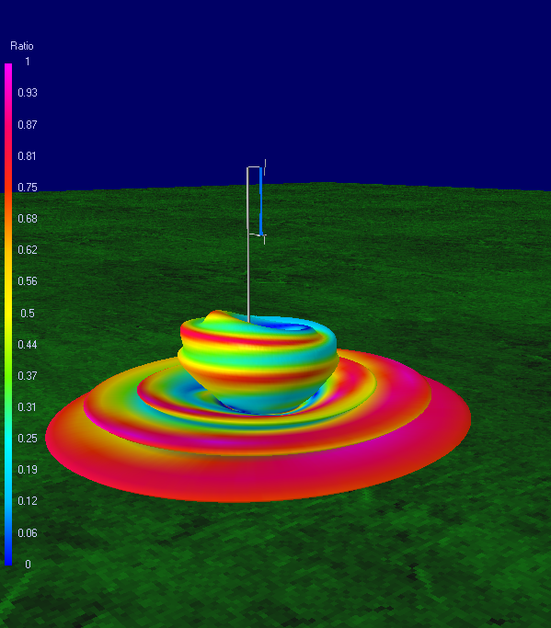
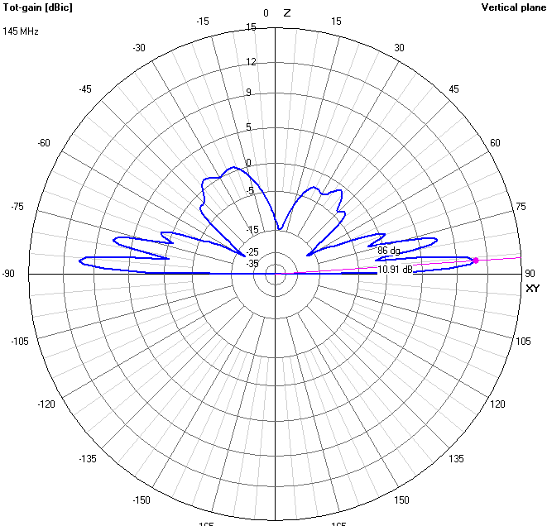
Final Design Simulation
Axial Ratio = 1 about horizontal
10.91 dBi of gain

Slide 29
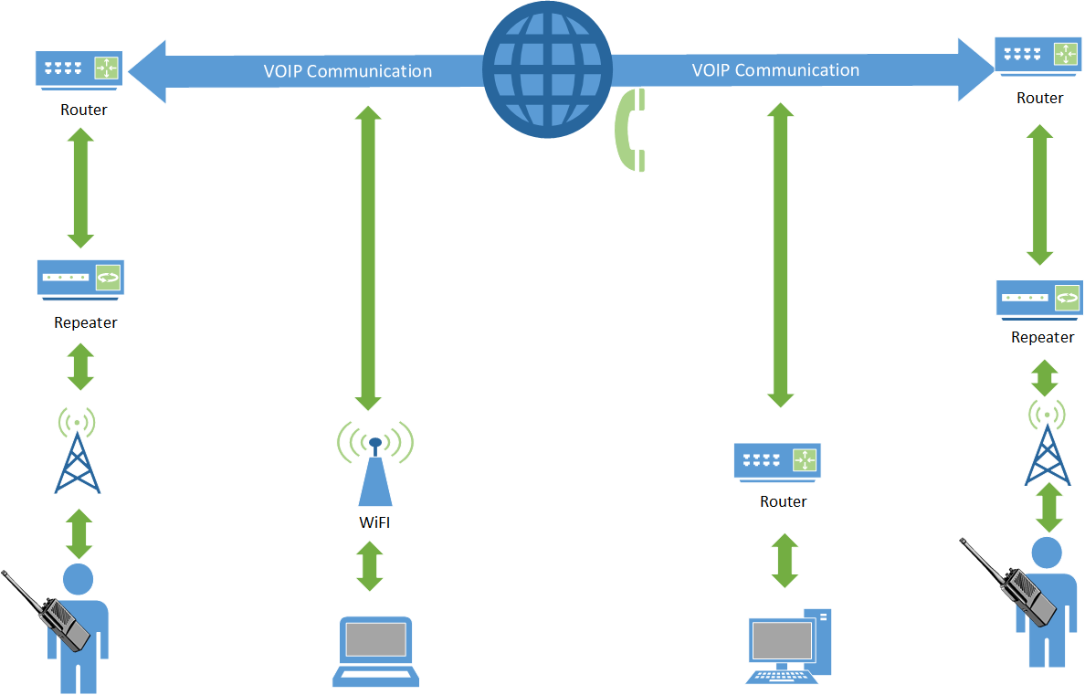
RoIP System Overview

Slide 30

Echolink Overview
Open source VoIP system for amateur radio users
Originally developed for windows, but later expanded to OS X and linux
Over 200,000 validated users, about 5,000 online at any given time
Security is based on callsign validation
No known cases of malware or viruses from echolink (because it cant accept file data)

Slide 31
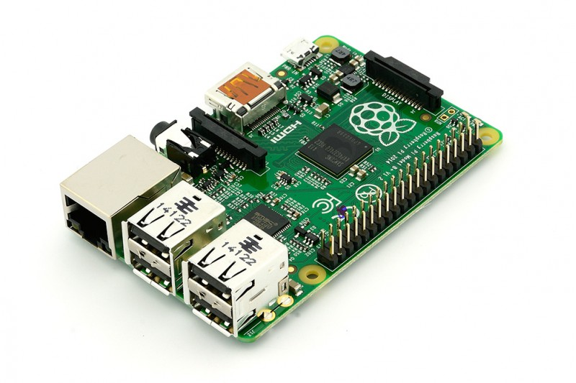
Echolink: Approach
Linux based single board computer (Raspberry Pi)
Software used is SVX Link, an open source VoIP software package for amatuer radio
Remote activation from field via DTMF commands
Built in DTMF decoder

Slide 32
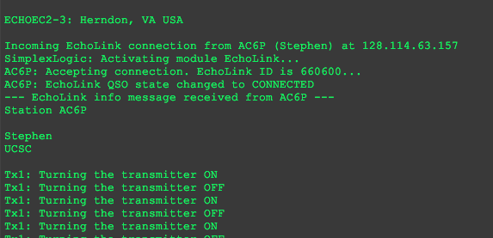
Echolink: Initial Design
Configured in Raspbian OS
Configured static IP for SSH access on UCSC network
User interface available by SSH
Runs as a Daemon background process
Control signals configured via GPIO pins on Raspberry Pi

Slide 33
Echolink: Challenges
Controlling audio output so that both nodes can’t transmit at the same time
Customization to fit our multi-node design

Slide 34
All Star Link Overview
Open source network for licensed amateur radio operators
Linux Based Software
Digital Signal Processing Software
PL tone decoding
DTMF decoding
Asterisk PBX
Software implementation of telephone switching system
Flexible connections via telephone system and internet

Slide 35
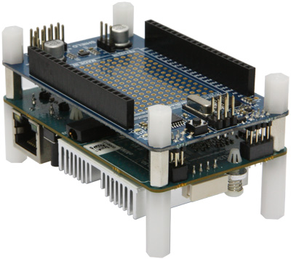
Approach and Initial Design
IRLP
Closed source
Required purchase of their products
Odroid U3
High Processing Power
CM 108 Audio Codec
U3 I/O Daughter Board for GPIO signals
PTT, COS, MUTE

Slide 36
Challenges
Software Installation
Custom Asterisk PBX version and repeater controller software, AppRPT
Outdated Software Packages
Device Driver Incompatibility
Little Documentation
Automatic Installation
No support for Odroid
No support for SBC GPIO configuration
UDP Port Access

Slide 37
Linking Interface Overview
Central hub for all audio going between modules (DTMF controller, VoIP nodes) and the repeater
Handles digital control signals between modules and the repeater
Provides power to other modules within the system

Slide 38
Linking Interface: Approach
Audio distribution amplifier for audio going to modules
Audio summing amplifier for audio going to the repeater
Embedded logic to prevent simultaneous audio transmission to repeater from VoIP nodes

Slide 39
Linking Interface: Initial Design
3.5mm mono audio jacks for audio connections
Potentiometers (logrithmic, 10k) on audio channels going to repeater to allow for gain control on individual audio channels
If one node is transmitting audio to repeater, other VoIP node is sent a ‘mute’ signal which is interpreted via a GPIO pin on each SBC, in the event that both nodes begin transmitting at the same time, Echolink is given priority
Powered off of the same 12v supply that powers the repeater

Slide 40
Linking Interface: Challenges
Control logic on first 1st rev was over complicated and needed simplification
The LM-2936 LDO didn’t give a steady 3.3v rail. Required additional capacitors to filter out high frequencies
Heat dissipation from voltage regulators powering SBCs

Slide 41
Linking Interface: Final Design
Linking interface also provides power for the SBCs and DTMF controller
Linking interface has DTMF controller stacked on top of it as daughter board
Linking interface, DTMF controller, and SBCs are all within same casing

Slide 42
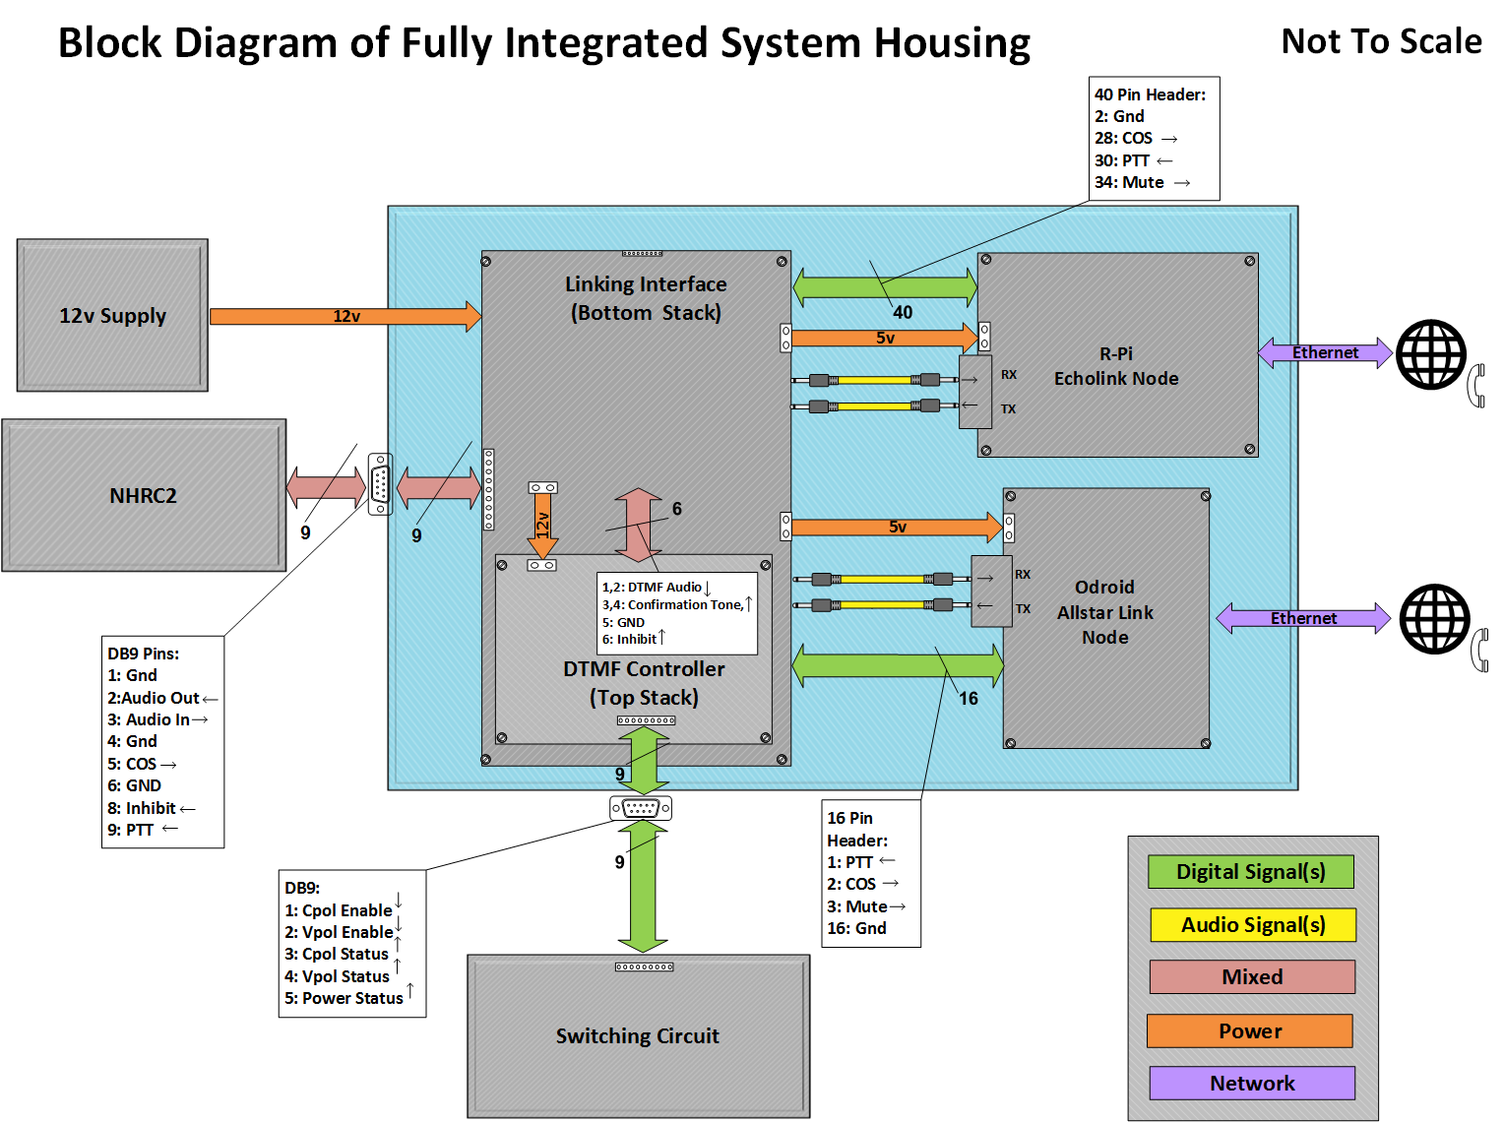

Slide 43
Future Work
Final printed circuit board fabrication
Permanent system enclosures
Mount and test mutli-element antenna array

Slide 44
Acknowledgements
Stephen Petersen (AC6P)
Jeff Bertalotto (KK6JGXXX)
Local Amateur Radio Community

Slide 45
System Demonstration

Slide 46
Thank You.

